Slide 1
Part II
Elementary Statistical Methods
Descriptive Statistics

Slide 2
Elementary Statistical Methods
Chapter 10
Bi-variate Data
Slides are Made by
Tamer Oraby
UTRGV

Slide 3
Outline:
1. Graphical representation of bi-variate data: scatter plot.
2. Numerical summary of bi-variables: correlation.
3. Slope – y intercept – best fit (or least squares) regression line – prediction.

Slide 4
Bi-variate data
Graphs
Scatter plot
Measures
Linear correlation coefficient
Estimate least squares regression line
And use it to assess association
And use it to assess association
To …
◊ assess it’s strength
◊ use it for predictions
◊ understand slope & intercept

Slide 5
Data …
is made from two numerical/quantitative variables $x$, $y$
$x$: an independent variable …
also called explanatory or predictor variable
$y$: a dependent variable …
also called response or predicted variable
Because …
Changes in $y$ are dependent on changes in $x$
Changes in $y$ are response to changes in $x$ and changes in $x$
explain changes in $y$
Changes in $x$ can be used to predict changes in $y$

Slide 6
Example :
An Unhealthy Commute The following Gallup organization regularly surveys adult Americans regarding their commute time to work. In addition, they administer a Well-Being Survey. According to the Gallup Organization, “ The Gallup- Healthways Well-Being Index Composite score is comprised of six sub-indices: Life Evaluation, Emotional Health, Physical health, Healthy Behavior, Work Environment and Basic Access.” (.Pg. 188):
Explanatory variable (x)
Response variable (y)
Commute Time ( in minutes) | Well-Being Index Composite score
5 | 69.2
15 | 68.3
25 | 67.5
35 | 67.1
50 | 66.4
72 | 66.1
105 | 63.9
Individual 1
Individual 2
Individual 3
Individual 4
Individual 5
Individual 6
Individual 7

Slide 7
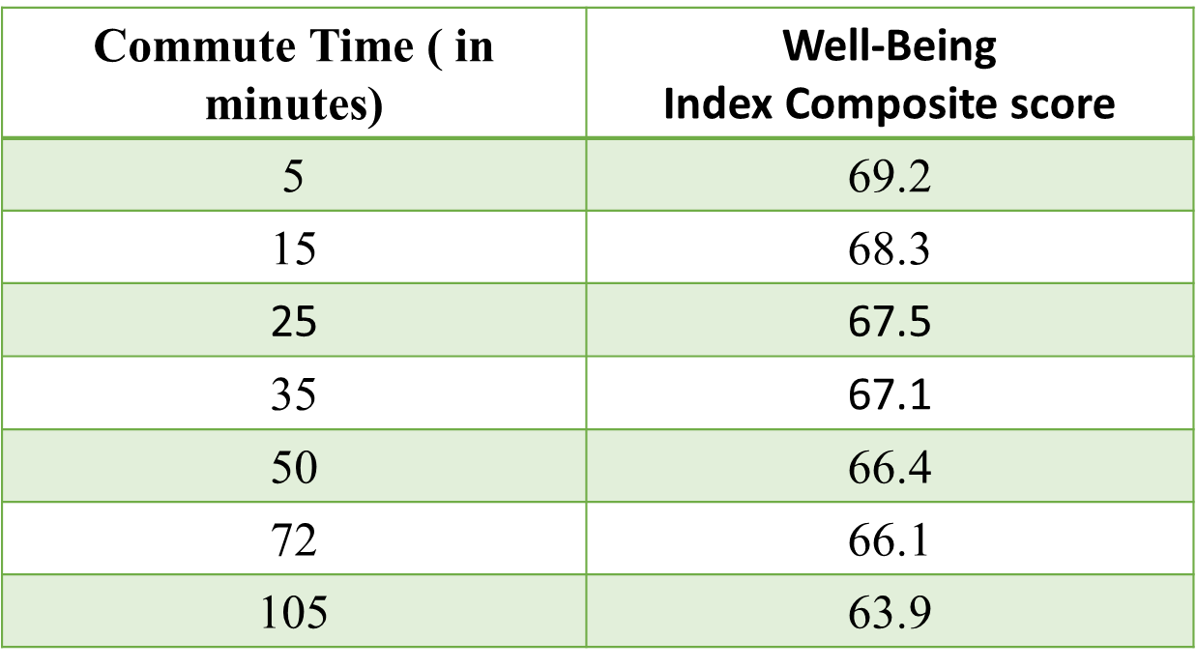
Scatter plot
Individual 1
Individual 2
Individuals don’t have to be
ordered nor be labeled on the graph.
Linear relationship
Individual 7
As the commute time increases the Index Composite score decreases
“ negative association“

Slide 8
Some other possible scatter plots for other data …
Linear relationship
As the explanatory variable increases the response variable increases
“positive association“

Slide 9
Other forms of relationships
Nonlinear
No relationship

Slide 10
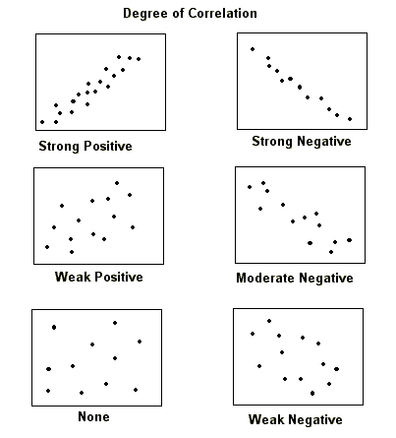
Degrees of association

Slide 11
But graphs alone might be misleading like when you zoom out in the last scatter plot
No relationship
It appears like linear because of zooming out or changing the y- scale

Slide 12
How to measure degree of linear association between $x$ and $y$?
Linear ( Pearson ) correlation coefficient:
Where
r is unitless.
r is always between -1 and 1, inclusively.

Slide 13
Degrees of association
No linear
relationship
perfect
perfect
strong | moderate | weak | weak | moderate | strong
Based on
where is
the value
of r, we can determine the strength and direction of the linear relationship.
-1
- 0.7
- 0.3
0
0.3
0.7
1
Negative association
Positive association
Warning: Actual cut-off points don’t exist in real life.

Slide 14
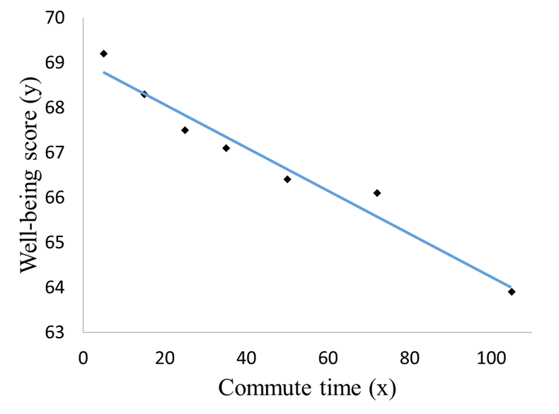
Example:
Negative association
Strong linear relationship
Warning: Correlation vs. Causation

Slide 15
How to calculate the correlation coefficient r?
$$x$$ | $$y$$ | $$\frac{x−\overline{x}}{s_{x}}$$ | $$\frac{y−\overline{y}}{s_{y}}$$ | $\frac{x−\overline{x}}{s_{x}} ∗$ $\frac{y−\overline{y}}{s_{y}}$
5 | 69.2 | -1.111 | 1.328 | -1.476
15 | 68.3 | -.8248 | .80224 | -.6617
25 | 67.5 | -.539 | .33427 | -.1802
35 | 67.1 | -.2531 | 1.0028 | -.0254
50 | 66.4 | 1.7557 | -.3092 | -.0543
72 | 66.1 | .80436 | -.4847 | -.3899
105 | 63.9 | 1.747 | -.772 | -3.096
 |  |  | Total | -5.883
$$\overline{x}=43.857$$
$${ s}_{x }=34.988$$
$\overline{y}$=66.929
$$s_{y}=1.709$$
The correlation coefficient $r=\frac{−5.883}{7−1}=−0.98$

Slide 16
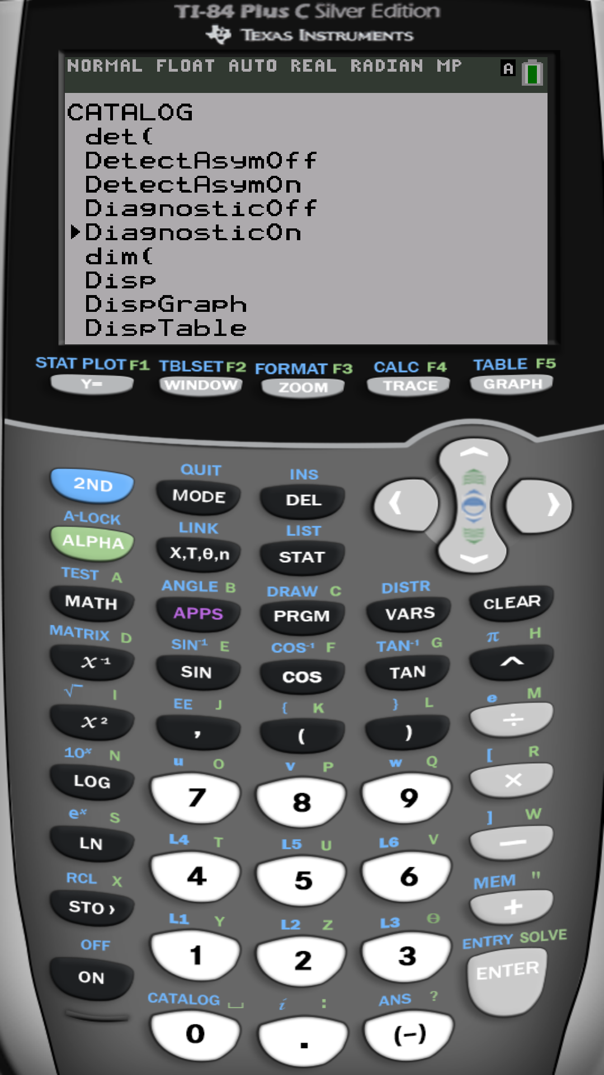
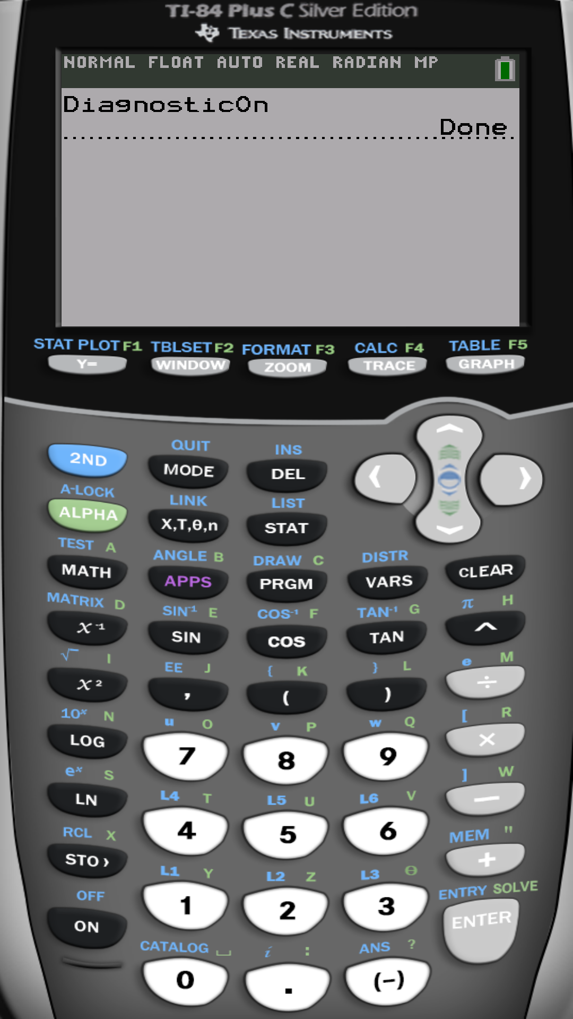
OR by calculator
This slide is to be done once and for
all unless you reset your calculator.

Slide 17
Using Calculator TI-84 Plus
Data entry
Press [STAT] key
Choose [Edit…]
Enter x into list 1 [L1]
Enter y into list 2 [L2]
Statistics calculations
Press [STAT] key
Choose [CALC]
Choose option 4: [LinReg (ax+b)]
Xlist: L1
Ylist: L2
On some calculators you do
LinReg (ax+b) L1 , L2

Slide 18
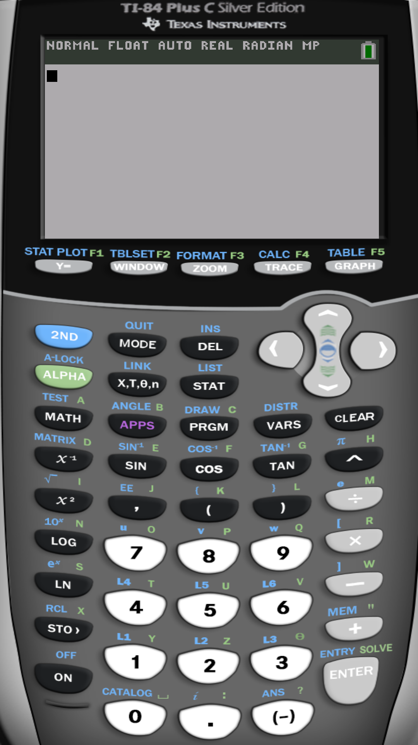
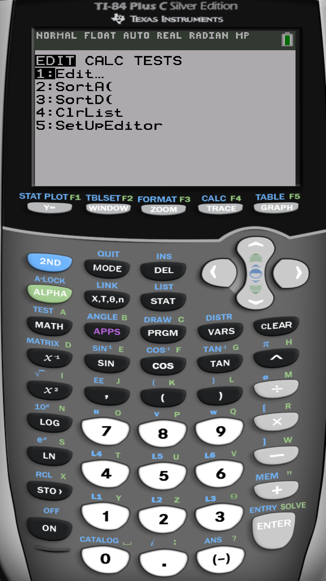

Slide 19
For the same sample:

Slide 20
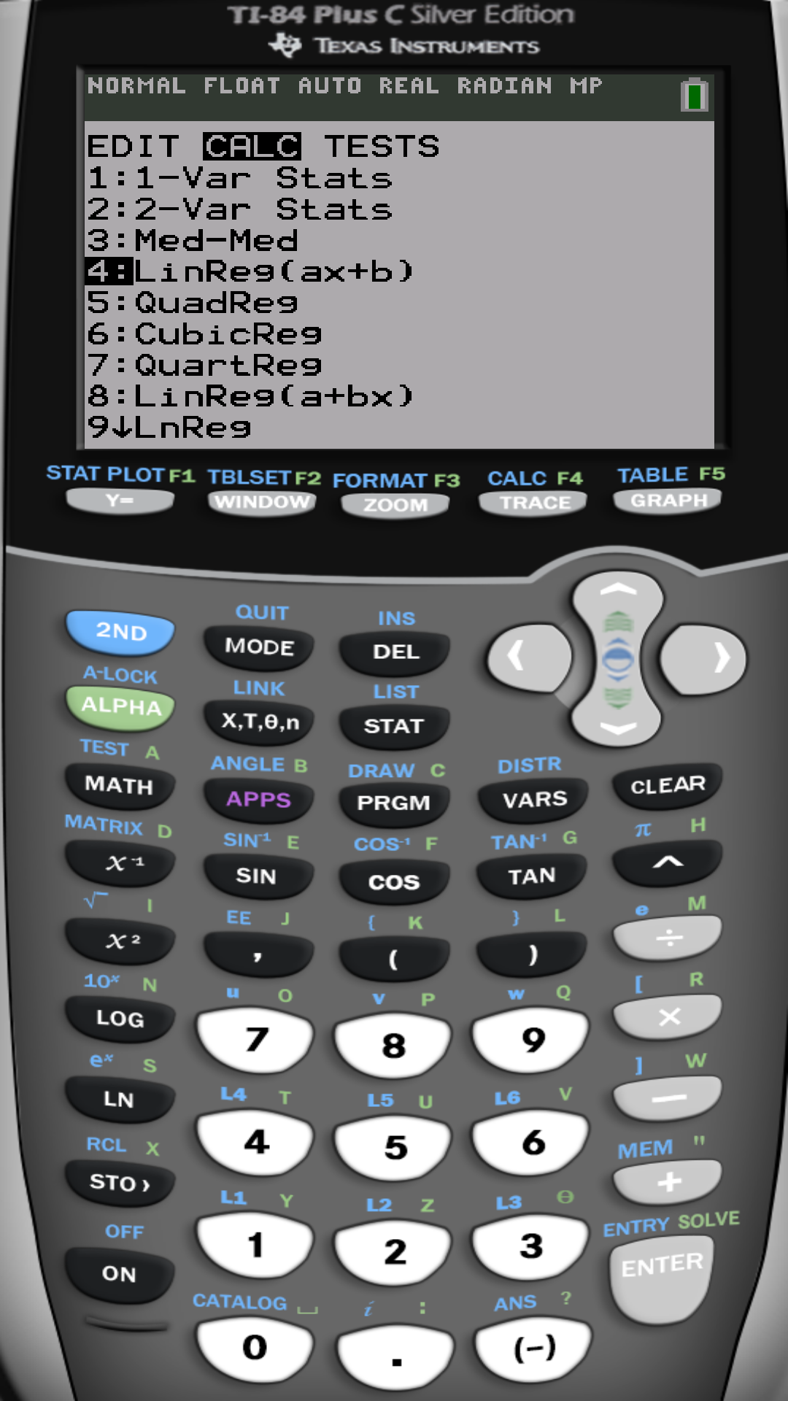

Slide 21
The correlation coefficient is

Slide 22
10.2 Least Squares Regression
What is a line?
$y$- intercept
slope
The intercept $b$ has the units of $y$
If $a > 0$
The slope $a$ has the units of $y$ per units of $x$
$$y$$
Positive association
$$y = ax + b$$
$a$ units increase in y
One unit increase in x
b
$$x$$

Slide 23
$$y$$
One unit increase in $x$
If $a < 0$
Negative association
$|a|$units decrease
in y
b
$$y = ax + b$$
$$x$$

Slide 24
To summarize:
The y-intercept $b$ is the value of $y$ when $x=0$
The slope $a$ is the amount of change in the value of $y$ when $x$ increases by one unit.
increase or decrease [after removing the (-) sign]

Slide 25
Example:
$$y$$
$$y$$
One unit increase in x
2 units increase in y
$$y = 2x + 3$$
4 units decrease
in y
One unit increase in x
5
$$y = −4 x + 5$$
3
$$x$$
$$x$$
$$a=2 > 0$$
$$a=−4 < 0$$
Positive association
Negative association

Slide 26
Given bi-variate data, how can we find the best fit regression line?

Slide 27
The best fit (least-squares) regression line $\hat{y}=a x+b$ to the data is that line with the least (minimum) possible squared “vertical“ deviations (errors) from the data points.
Method of least squares
vertical deviations $=y_{i}−(a x_{i}+b)$
$$\sum{\text{vertical} \text{deviations}\text{2}}=\sum_{i=1}^{n}{{\left[y_{i}−(a x_{i}+b) \right]}^{2}}$$
When minimized as a function in $a$ and $b$
we get the best
with
and

Slide 28
Example :
Find the best fit (least squares) regression line if the correlation between the explanatory variable and the response is 0.25 and the mean and standard deviation of the explanatory variable are 25 and 2.5, respectively. Meanwhile, the mean and standard deviation of the response variable are 10 and 1, respectively. Predict the response to a value of $x=30$.
and
Thus, the best fit (least squares) regression line
When $x=30$,

Slide 29
Example :
An Unhealthy Commute The following Gallup organization regularly surveys adult Americans regarding their commute time to work. In addition, they administer a Well-Being Survey. According to the Gallup Organization, “ The Gallup- Healthways Well-Being Index Composite score is comprised of six sub-indices: Life Evaluation, Emotional Health, Physical health, Healthy Behavior, Work Environment and Basic Access.” (.Pg. 188):
Commute Time ( in minutes) | Gallup - Healthways Well-Being Index Composite score
5 | 69.2
15 | 68.3
25 | 67.5
35 | 67.1
50 | 66.4
72 | 66.1
105 | 63.9

Slide 30
For the same sample:

Slide 33
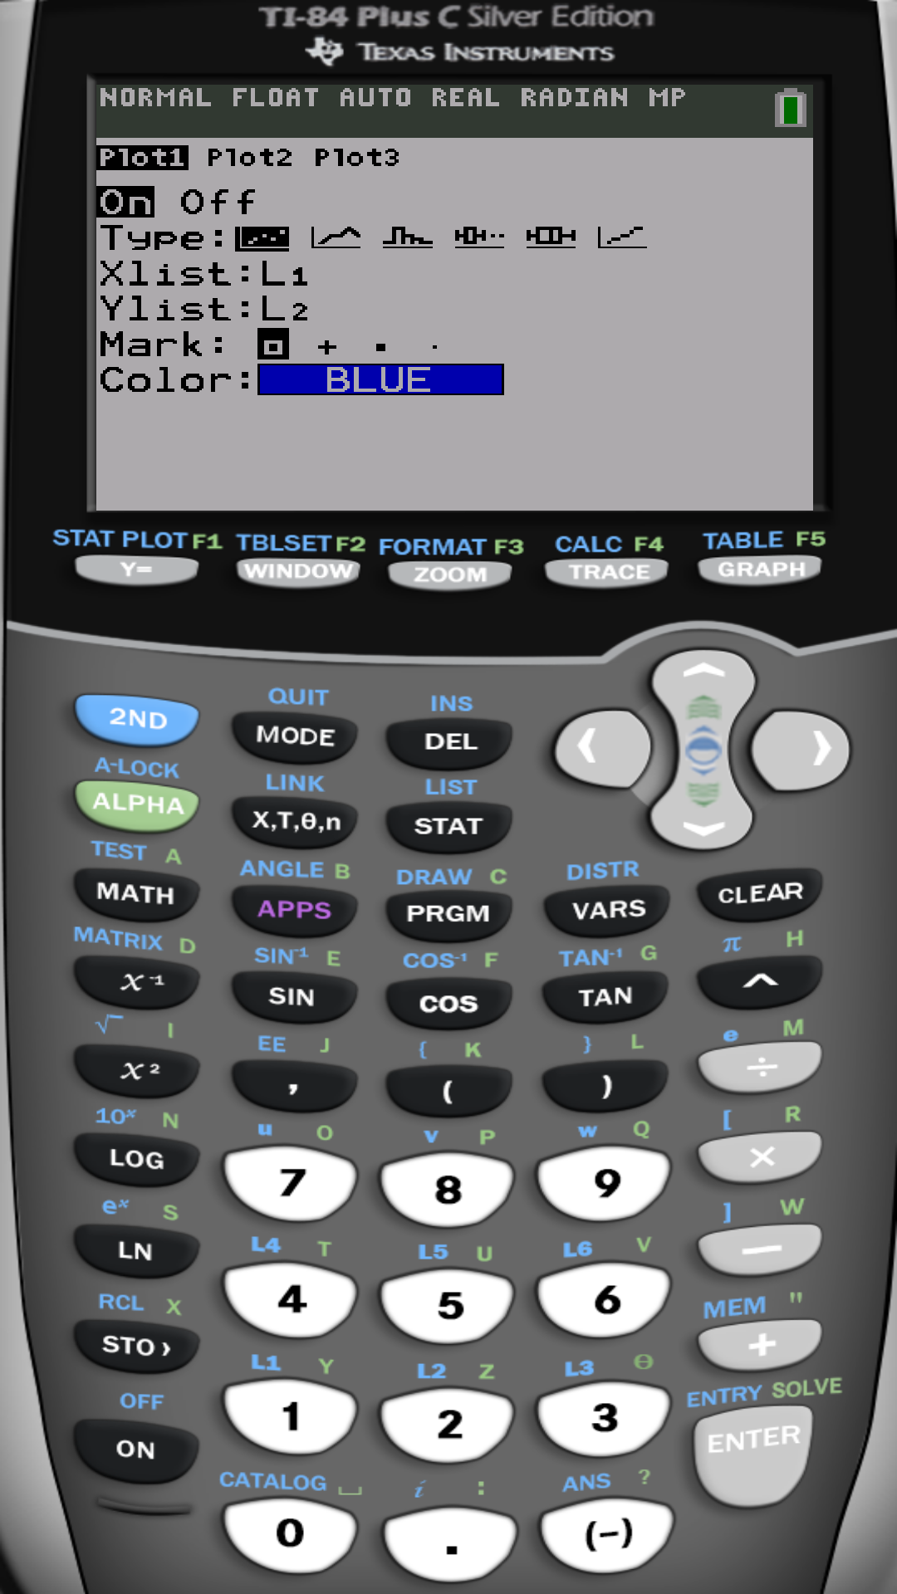
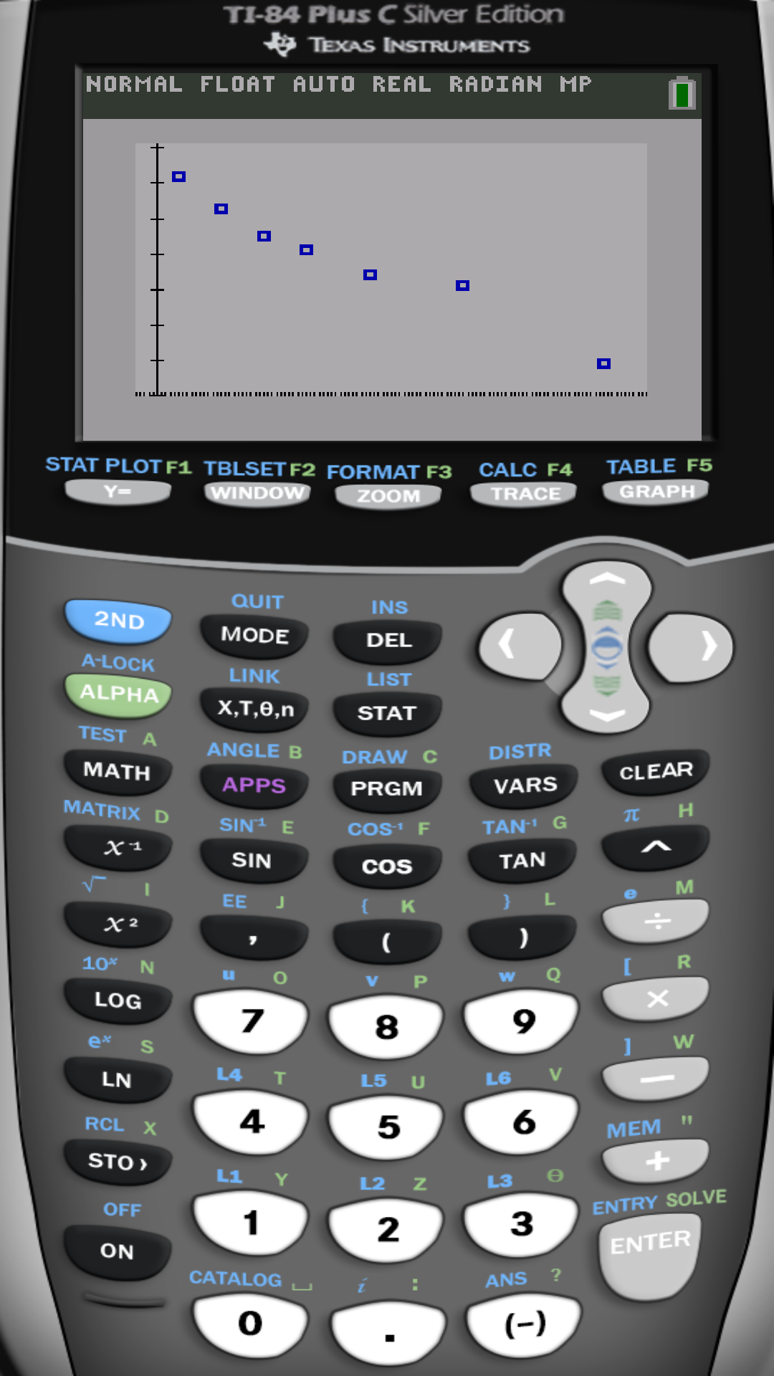

Slide 34
(a) Find the least squares regression line treats the commute time, x, as the explanatory variable and the index score, y, as the response variable
(b) Interpret the slope and y-intercept, if appropriate.
If the commute time increases by 1 minute, then the index decrease by 0.0479. The well-being score of 0 minutes commute is 69.0296.
(c) Predict the well-being index of a person whose commute time is 30 min.
When x = 30,
(d) Suppose Barbara has 20-min. commute and score 67.3 on the survey. Is Barbra more “ well-off” than the typical individual who has a 20-min. commute?
Then Barbra is less “ well-off .”

Slide 36
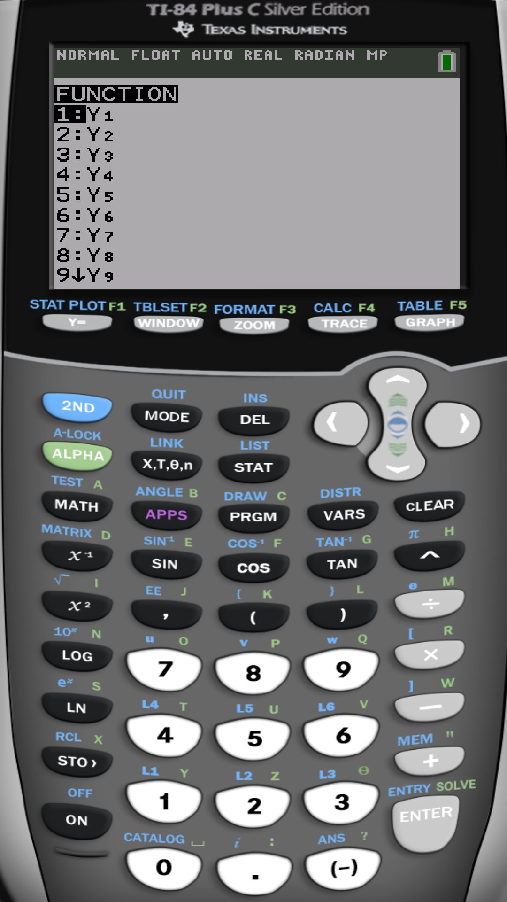

Slide 37
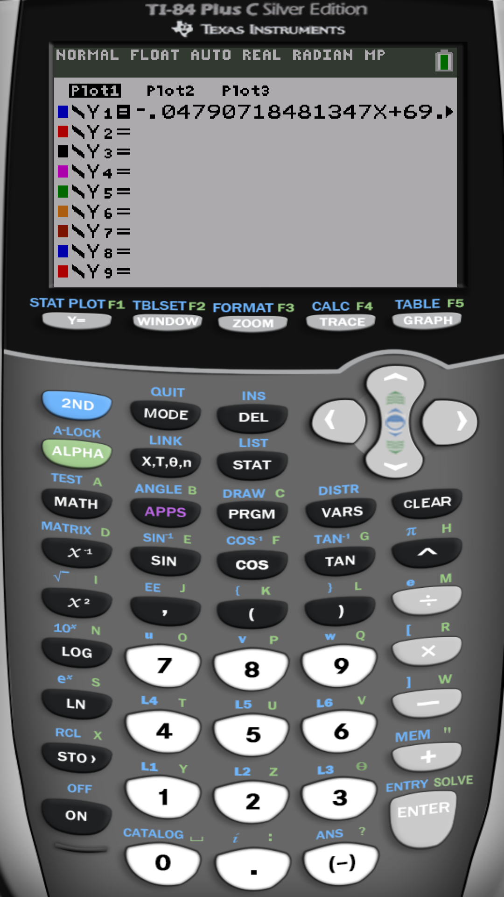
On some calculators you do
LinReg (ax+b) L1 , L2, Y1

Slide 38
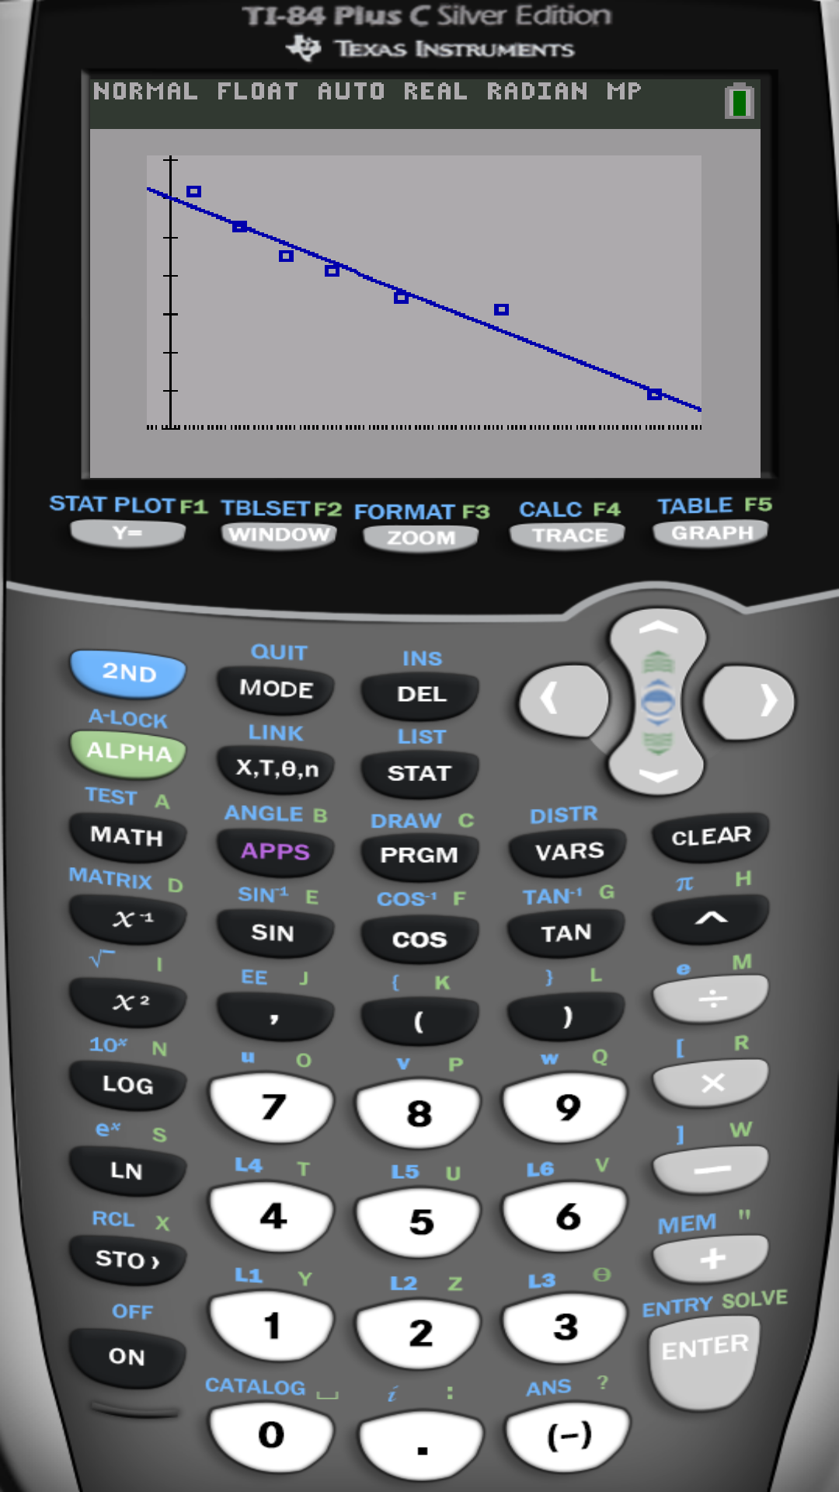

Slide 39
How to measure the adequacy of the linear relationship
to model the relationship between x and y?

Slide 40
Coefficient of determination measures the adequacy of the linear relationship between x and y.
Percentage of the variability in the data explained by the line.
The rest of it is the percentage of vertical variability (above and below the line).
The closer to 100 % the more adequate the linear relationship to describe the relationship between x and y.

Slide 41
Using the statistical software R
R is a free professional statistical software
Download and install for free from
https://www.r-project.org/
Free on-line R compiler
http://rextester.com/l/r_online_compiler

Slide 42
Example: We will perform simple linear regression between x=age and y=price
# Enter data into R
Age=c(5,4,6,5,5,5,6,6,2,7,7)
Price=c(85,103,70,82,89,98,66,95,169,70,48)
# Scatter plot
plot(age,price,main='Age vs. Price Scatterplot',xlab='Age',ylab='Price')
# Linear correlation coefficient
cor(age,price)
# Linear Regression analysis
fit=lm(price~age) # find the best fit regression line (as a linear model lm)
summary(fit) # show the results
predict(fit,data.frame(age=3)) # predict price for age=3

Slide 43
End of Chapter 10

Slide 44
End of
Elementary Statistical Methods

